Slide 1
Career Development Training Course
Enlisted Assignment Special Programs

Slide 2
Enabling Objective
IDENTIFY the types of Enlisted Special Programs available
DISCUSS eligibility requirements
IDENTIFY forms required for completion
Notes:
FACILITATOR GUIDE:
Review objectives.

Slide 3
References
Navy Military Personnel Manual (MILPERSMAN), NAVPERS 15560 (series)
MyNavyHR Website- https://www.mynavyhr.navy.mil/
MILPERSMAN 1306-900, Assignment of Enlisted Personnel to Special Programs
OPNAVINST 1500.75(series), Policy and Governance for Conducting High-Risk Training
Manual of the Medical Department (MANMED) P-117, chapter 15 article 15-95
Notes:
FACILITATOR GUIDE:
Review references.

Slide 4
Assignment to Special Programs
Motivated Sailors looking for challenging and rewarding tour assignments should apply for Special programs.
These tours provide opportunities for sailorization, development of leadership skills, mentorship, and overall fleet impact.
Special programs are divided into two categories:
  Sea Special programs (PERS 409)
  Shore Special programs (PERS 4010)
Sailors can request assignment to Sea or Shore special programs by:
  Contacting rating detailer for release to special program assignment.
  Discuss Special Program opportunities at C-Way, MNA or Separation CDBs so they don’t miss opportunity.
  Submit NAVPERS 1306/7, 14-16 months prior to their PRD.
Notes:
FACILITATOR GUIDE:
1. Sailors must contact their detailer to get released to special programs prior to entering their normal window to apply for orders; if not they will risk becoming a detailer asset and may not receive approval to apply for special program assignments.
2. Ensure Sailors are utilizing most updated MILPERSMAN or NAVADMIN.

Slide 5
Special Program Screening Form NAVPERS 1306/92
Is the primary form to screen Sailors for Sea and Shore special programs
It can be found on MyNavyHR:
  References<Forms<NAVPERS
Each program provides guidance for completion (i.e. fill in Section A and C only)
When verifying each section ensure to include supporting documentation for accuracy such as:
  Evaluations
  PRIMS data
  Member Data Summary (NSIPS)
  DAPA screening
Notes:
FACILITATOR GUIDE:
Emphasize to read the MPM that applies to the program the Sailor is applying for because each program has different requirements and may not require all sections to be completed.
Section A should be completed by Admin Officer or Personnel Officer *this can also be either the YN or PS Chief*. Some commands may have a 1st class serving in this role. As long as they are designated as such they can also complete this section. Ensure to have supporting documentation for each section for verification. If OBLISERV is not complete; ensure to make a note on the form to annotate if it will be completed upon receipt of orders.
DAPA can provide a generate Page 13, annotating the service has been screened and meet the requirements for assignment to special programs.

Slide 6
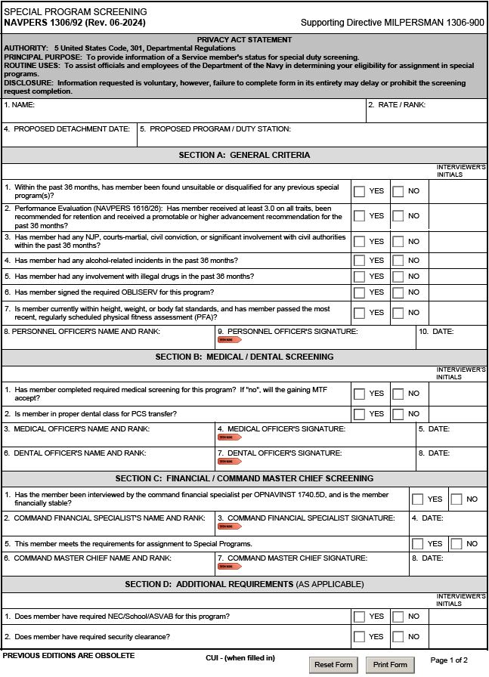
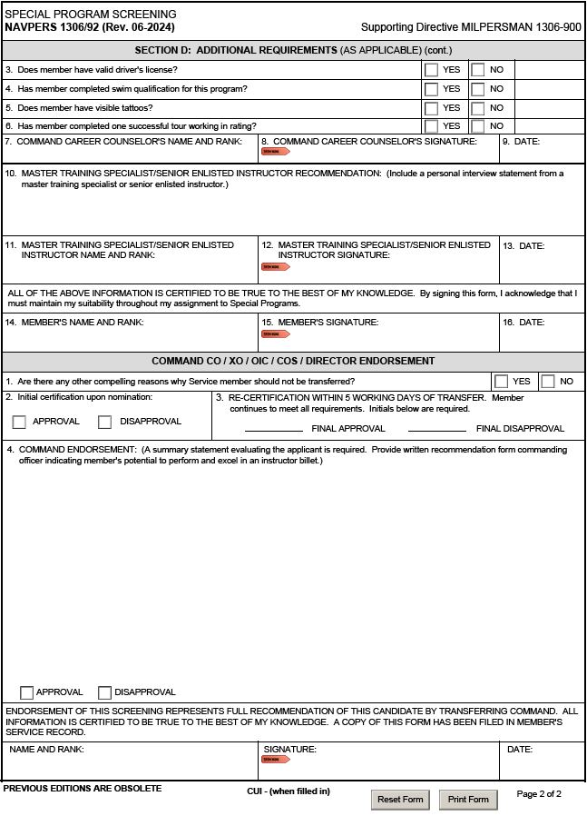
NAVPERS 1306/92
Refer to the corresponding program MILPERSMAN article for the required screening sections to complete.
SAMPLE
SAMPLE
Notes:
FACILITATOR GUIDE:
Advise CDT members on how to properly complete the NAVPERS 1036/92
Emphasize to read the MPM that applies to the program the Sailor is applying for because each program has different requirements and may not require all sections to be completed.
Section A should be completed by Admin Officer or Personnel Officer *this can also be either the YN or PS Chief*. Some commands may have a 1st class serving in this role. As long as they are designated as such they can also complete this section. Ensure to have supporting documentation for each section for verification. If OBLISERV is not complete; ensure to make a note on the form to annotate if it will be completed upon receipt of orders.
Completion of the remainder sections are self-explanatory

Slide 7
Shore Special Programs (PERS-4010)
Currently has over 14,000 Sailors detailed
Not geared toward a specific rating
The following programs will be highlighted however utilize MyNavy HR to find new and current opportunities:
  Naval Recruiting
  Recruit Division Commander (RDC)
  Enlisted Detailing
  Embassy Duty
  USS Constitution
  Instructor Duty
Notes:
FACILITATOR GUIDE:
1. The next few slides will provide examples of the types of Shore Special Programs available to Sailors.
2. CDT members must ensure to read the appropriate MPM article and any related NAVADMINs for special programs assignment to verify the current screening requirements.

Slide 8
Instructor Duty
MILPERSMAN 1306-953
Instructors are detailed to commands responsible for formal training programs of military or civilian personnel.
Requirements:
  E5 and above.
  Complete all sections of 1306/92
  Within PFA standards.
  Read aloud test
    Administer by local MTF, Independent Duty Corpsman (IDC), medical officer, or Master Training Specialist .
  High Risk Training (as applicable)
    Required for personnel detailed to training environments which exposes the crew, staff, and students to potential risks of death, permanent disability, or loss during training.
  Complete requirements sent via naval message from detailer.
Tour Length:
    36 months
Notes:
FACILITATOR GUIDE:
Read aloud test can be retrieved from medical.
OPNAVINST 1500.75D has the requirements of High-Risk training screening.
Manual of the Medical Department (MANMED) P-117, chapter 15 article 15-95 (discusses read aloud test).
Additional screening requirements/instructions will also be sent via naval message from the detailer.
Instructor duty examples:
“A” and “C” schools
ATG
Senior Enlisted Academy
Professional Development Instructor (PDI)
NOTE: If you are in communities such as Medical, Submarines, Nuclear recommend providing instructor duty examples that are unique to those communities as well.

Slide 9
Enlisted Rating Detailer
MILPERSMAN 1306-966
Key player in the distribution and placement of enlisted personnel.
Duties include:
  Communicating with Sailors (MyNavy Assignment, phone, email).
  Discuss assignment options and provide advice.
  Coordinate with distribution management and manning stakeholders.
Responsible Office PERS-4010F
Forward package to respective rating detailer.
Notes:
FACILITATOR GUIDE:
Additional information can be found at: Career-Management<Detailing<Enlisted<Shore Special<Enlisted-Detailing

Slide 10
Enlisted Rating Detailer cont…
Detailer candidates must meet the following minimum standards:
  No EVAL traits below 3.0, recommended for retention and received a promotable or higher for the past 36 months.
  No NJP, courts-martial conviction, or civil conviction within the past 36 months.
  No ARI's within the past 36 months.
  Must be within current BCA standards and passed the most recent PFA.
  No record of financial instability within the past 36 months.
  Eligible for a Secret security clearance.
  Be in accordance with normal sea/shore flow.
  Tour length:
    36 months
Notes:
FACILITATOR GUIDE:
None.

Slide 11
Enlisted Rating Detailer cont…
Detailer Nomination Package Contents:
  Commanding Officer's letter of recommendation.
  Completed NAVPERS 1306/92 Special Program Screening.
  Recent full-length photograph with a three-quarter view in a short-sleeved uniform (Provide close-up of any tattoos).
  EVALs for the past 36 months.
Notes:
FACILITATOR GUIDE:
None.

Slide 12
Recruiting Duty
MILPERSMAN 1306-964
A rewarding program with incentives such as:
  Special Duty Assignment Pay (SDAP) up to $450
  Meritorious Advancement Program
  Training (Sales Skills)
  Opportunity to be stationed at a variety of locations
Responsible Office is PERS 4010C1
Contact rating detailer for the available districts and to have a Sailor nominated for Recruiting.
Notes:
FACILITATOR GUIDE:
1. Highly recommend service members contact detailer PRIOR to in negotiation window for consideration.
2. Additional information at:
Career Management<Detailing<Enlisted<Shore Special<Recruiting

Slide 13
Recruiting Duty (cont’d)
Recruiting candidates must meet the following minimum standards:
  Currently open to Paygrade E-4 to E-8
  E-4 may qualify for E-5 under the STAR program (check CSL under STAR incentives)
  Current security clearance
  No performance marks lower than 3.0 in the past 36 months
  No NJPs in the past 36 months
  No PFA failures in the past 36 months
  Documented alcohol incident within previous 3 years or any two incidents during career is disqualifying
  Tattoos must meet criteria IAW current NAVADMIN and MPM
Notes:
FACILITATOR GUIDE:
These are only some of the screening requirements for RDC. See MPM article for specific requirements.

Slide 14
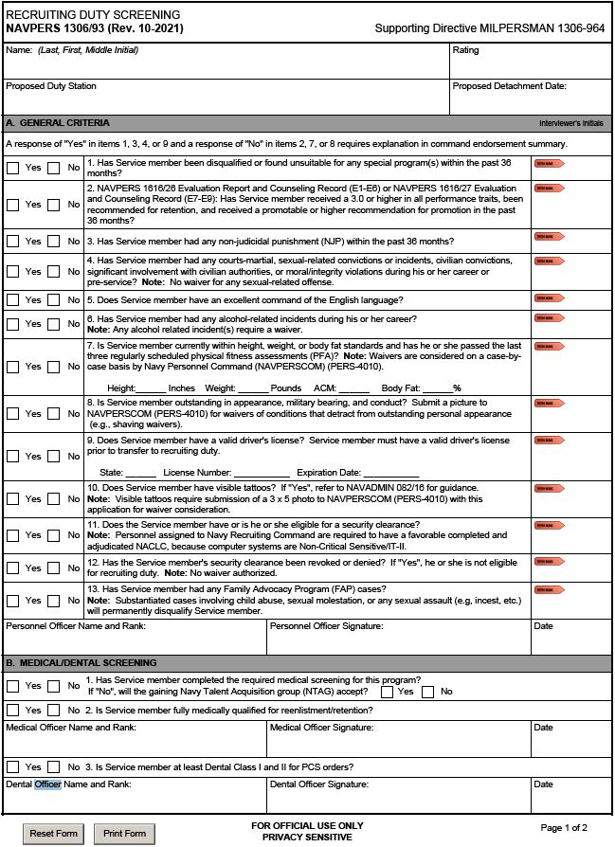
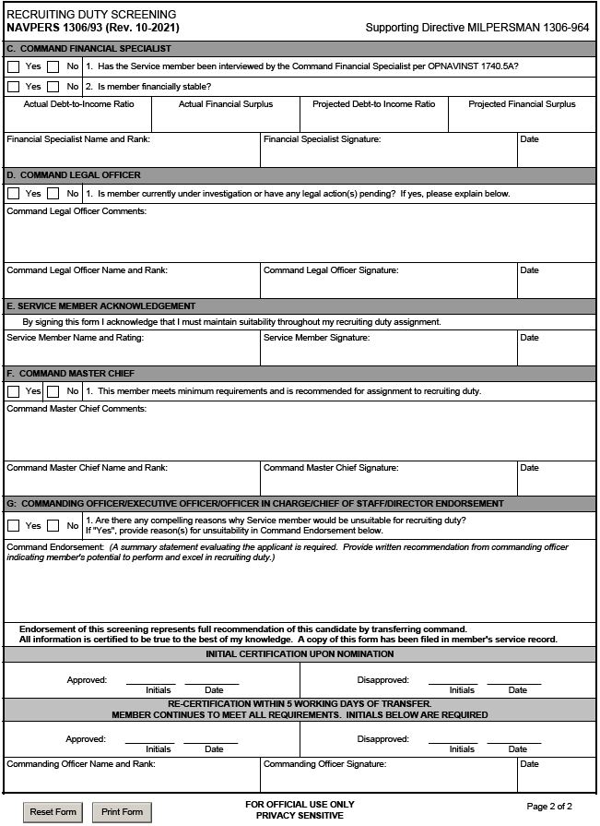


Recruiting Duty Screening NAVPERS 1306/93
Notes:
FACILITATOR GUIDE:
Review form.

Slide 15
Recruit Division Commander (RDC)
MILPERSMAN 1306-954
The #1 Sailorization and Mentoring shore duty. RDC offers:
  Special Duty Assignment Pay (SDAP) up to $450
  Additional clothing allowance and free dry cleaning
  Opportunity to earn Master Training Specialist qualification
  E7-E8 advancement is almost double the Navy average
Responsible Office PERS-4010D
Contact Shore Special Program Detailers to initiate the process
Notes:
FACILITATOR GUIDE:
Additional information can be found at: Career-Management<Detailing<Enlisted<Shore-Special<RDC

Slide 16
Recruit Division Commander cont…
RDC candidates must meet the following minimum standards:
  Paygrade E-5 to E-9
  No performance marks lower than 3.0 in the past 36 months
  No legal issues (waiver required for any NJP, Civil, moral issues)
  Medical and Dental ready (no issues that prevent full participation)
  Substantiated CMEO or FAP cases can be disqualifying
  No PFA failures in the past 36 months, and in BCA standards
  Documented alcohol incident within previous 3 years or any two incidents during career is disqualifying
  Tattoos must meet criteria IAW MILPERSMAN 1306-954
Notes:
FACILITATOR GUIDE:
These are only some of the screening requirements for RDC. See MPM article for specific requirements.

Slide 17
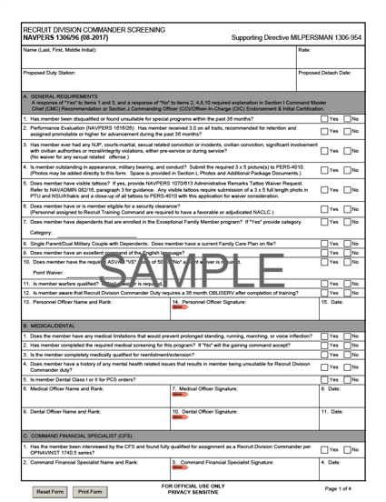
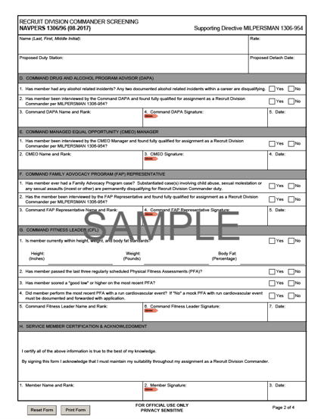
RDC Screening
NAVPERS 1306/96
Notes:
FACILITATOR GUIDE:
Review form.

Slide 18
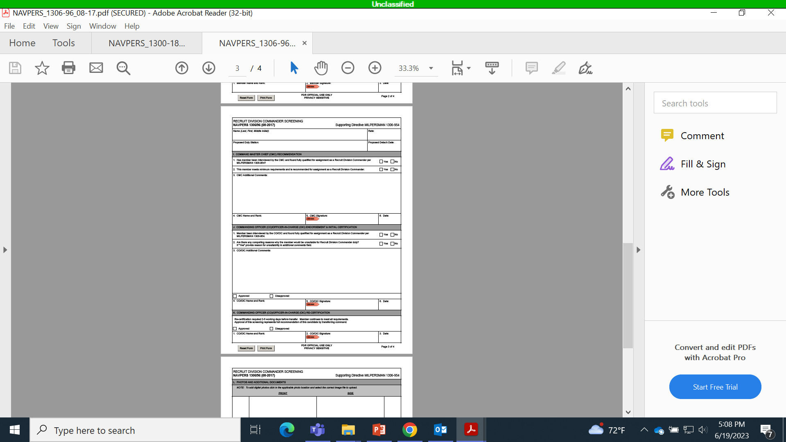
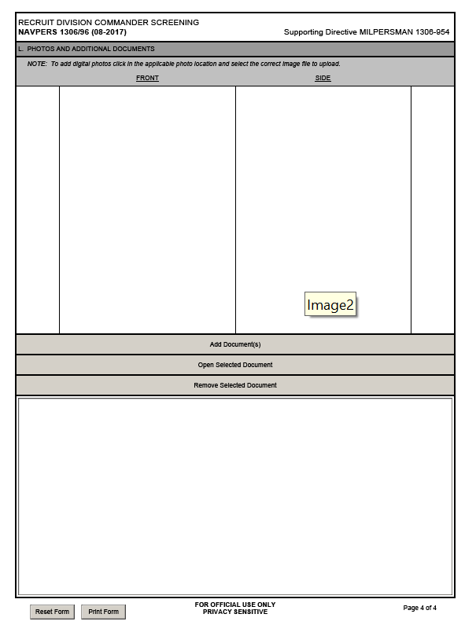
RDC Screening
NAVPERS 1306/96
SAMPLE
SAMPLE
Notes:
FACILITATOR GUIDE:
Review form.

Slide 19
Embassy Duty
MILPERSMAN 1306-914
Managed by PERS-4010G
Exotic & unique locations.
Serve as part of U.S. Defense Attaché Office (DAO) team, based in U.S. Embassies in more than 50 countries.
Responsibilities of Staff Support Members:
  Operations Coordinator (LDOs, CWOs, and E7/8/9)
    Liaison within the DAO, performs managerial duties
  Operations Assistant (E5-E8)
    Performs administrative and operational support functions for the DAO
Notes:
FACILITATOR GUIDE:
Additional information can be found at: Career-Management<Detailing<Enlisted<Shore Special<Embassy Duty

Slide 20
Embassy Duty cont…
Requirements:
  E5 and above
  TS SCI clearance
  Counterintelligence polygraph
  No NJP in past 36 months
  No record of drug or alcohol abuse
  No financial problems
  US citizen
  All dependents' US citizens
  DLAB score minimum 95
  Member and family must complete screenings (no waivers).
Notes:
FACILITATOR GUIDE:
Waivers will not be granted for the requirements listed with the exception of:
DLAB can be waived on case by case basis
Dual-citizen waivers can be provided for dependents on a case by case basis

Slide 21
USS CONSTITUTION
“Old Ironsides”
MILPERSMAN 1306-920
The oldest Navy ship still in commission.
Sailors are tasked with promoting, protecting, and preserving the ship.
Receives approximately half a million visitors annually.
Non-petty officers screened directly from RTC by CMDCM or CMDCS of USS Constitution (24 month tour).
Tour Length:
  E-1 through E-3 will serve 24 months
  E-4 through E-9 will serve 36 months
Notes:
FACILITATOR GUIDE:
See MPM for complete list of requirements.

Slide 22
USS CONSTITUTION cont…
Requirements:
  Must be able to interact with public with maturity and tact and be model representative of Navy in appearance and military bearing.
  ASVAB: WK=50, VE=50
  No NJP in past 36 months.
  No DUI in past 5 years.
  No financial instability in last 36 months.
  No eval traits below 3.0 in past 36 months.
  Must pass most recent PFA and have smart military appearance.
Homeported in Boston, MA
Notes:
FACILITATOR GUIDE:
Requirements cont…:
Be fit for full duty
No tattoos visible in short-sleeves or skirts (waiverable)
Not afraid of heights
Non-POs must be unmarried and without dependents

Slide 23
Sea Special Programs
(PERS-409)
Sea Special programs is responsible for the Navy’s:
  New Construction units
  LCAC detailing
  Fleet Decommissioning
  Disestablishment
  Homeport change coordination
The following programs will be highlighted:
  New Construction
  Landing Craft, Air Cushion (LCAC)
Notes:
FACILITATOR GUIDE:
None.

Slide 24
New Construction
MILPERSMAN 1306-802
Sailors have the opportunity to experience becoming a “plank owner.”
Pre-commissioning (PRECOM) of a new construction is a fast paced, demanding period that requires the highest level of performance from everyone assigned to include:
  Intensive efforts to establish the administrative and training readiness of the unit for future operations
  This stage is not equipped to handle excessive personnel-related administrative burdens
Responsible office is PERS-409/ PRECOM Detailer.
Notes:
FACILITATOR GUIDE:
Additional information is found at: MyNavyHR<Career Management<Detailing<Enlisted<Sea Special Programs

Slide 25
New Construction Minimum Standards
Candidates must be screened using NAVPERS 1300/18, New Construction Screening and meet the following minimum standards:
  No civil convictions, courts-martial, non-judicial punishments, or significant involvement with civil authorities in the past 12 months
  Not currently on legal hold or pending ADSEP
  Currently within BCA standards, and passed most recent PFA
  No history of serious physical or mental health problems
  Be able to complete OBLISERV:
    Minimum 24 months required after ship’s in-service or DOD area tour for those assigned overseas
Notes:
FACILITATOR GUIDE:
Standards cont....
No evidence of drug abuse in the past 12 months.
No alcohol-related incidents in the past 12 months.
Must be a U.S. citizen for nuclear ships (most rates).
Have performance marks of at least 3.0 in all traits, be recommended for retention, and receive a promotable or higher recommendation for the previous 24 months.
Additional Notes:
Personnel without prior sea duty, PRDs will be assigned as follow from the date of the ship’s in-service:
1st enlistment: assigned IAW PST for 1st sea tour
2nd or more: assigned IAW PST for the assigned rating (see sea/shore flow)
HYT waivers must be approved prior to issuance of orders to allow the Sailor to meet OBLISERV requirements:
Request via 1306/7 to BUPERS -328

Slide 26
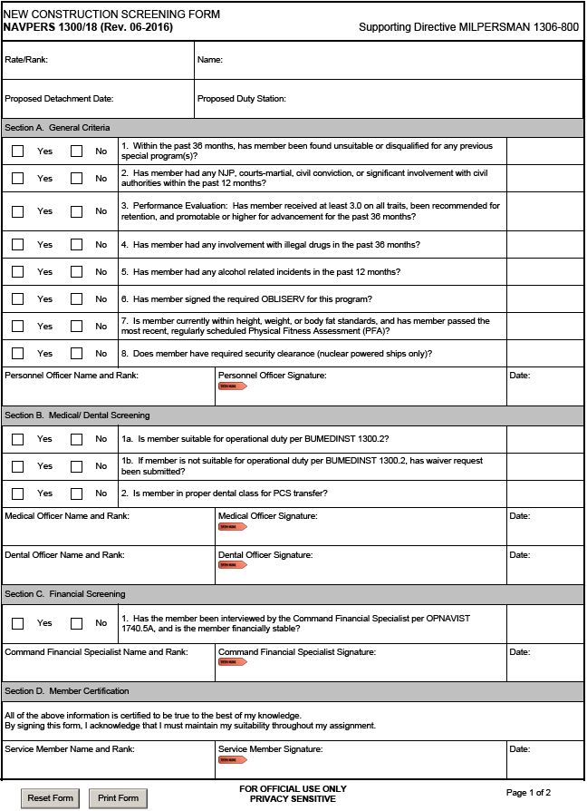
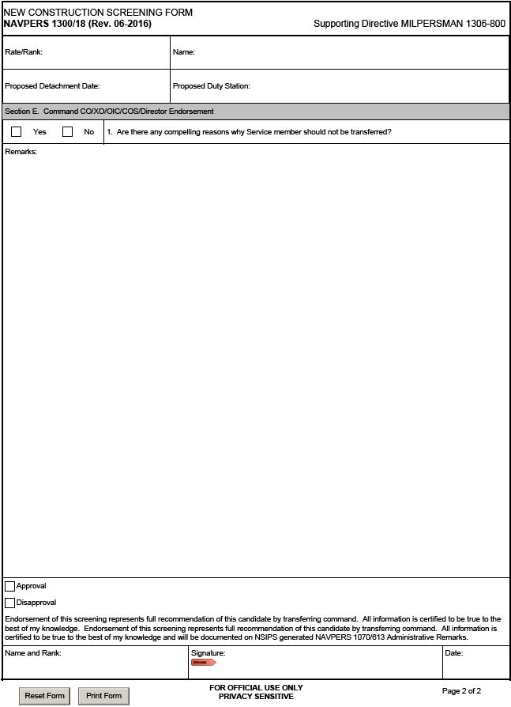
New Construction Screening Form
All sections must be completed
SAMPLE
SAMPLE
Notes:
FACILITATOR GUIDE:
Advise CDT members on how to properly complete the NAVPERS 1036/92
Emphasize to read the MPM that applies to the program the Sailor is applying for because each program has different requirements and may not require all sections to be completed.
Section A should be completed by Admin Officer or Personnel Officer *this can also be either the YN or PS Chief*. Some commands may have a 1st class serving in this role. As long as they are designated as such they can also complete this section. Ensure to have supporting documentation for each section for verification. If OBLISERV is not complete; ensure to make a note on the form to annotate if it will be completed upon receipt of orders.

Slide 27
Landing Craft, Air Cushion (LCAC)
MILPERSMAN 1306-949
$23-million-dollar Landing Craft manned entirely by enlisted crews with a CPO or above in charge.
Primarily used for transporting, ship-to-shore/across the beach personnel, weapons, equipment, and cargo for assault elements of the Marine Air-Ground Task Force.
Responsible Office is PERS-409/ LCAC Detailer.
Notes:
FACILITATOR GUIDE:
Additional details can be found at: Career-Management<Detailing<Enlisted<Sea Special<LCAC

Slide 28
LCAC Program cont…
LCAC candidates must meet the following minimum standards:
  2nd class swim qualified
  ASVAB score GS+AR+MK+EI = 204 or greater
  Be physically quailed IAW NAVMED P-117
  Complete the LCAC performance-based measurement test (LCAC BAM)
    Three lifetime attempts are allowed (min 30 days in-between each attempt)
    Current valid score will be used, even if previous scores were higher
  Complete the LCAC Service Life Extension Program Operations Prerequisite Course
  Valid security clearance
Notes:
FACILITATOR GUIDE:
See MPM article for additional screening requirements.

Slide 29
LCAC Program cont…
There are 5 LCAC crew members:
  LCAC Craftmaster (NEC-800A): open to all ratings E7-E9
  LCAC Engineer (NEC-729B): open to E5-E7
  LCAC Navigator (NEC-701B): open to E5-E7
  LCAC Loadmaster (NEC-700B): open to E3-E6
  Deck Engineer (NEC-728B): open to E3-E6
Each category has specific rating requirements consisting of Aviation and Surface ratings. For details go to:
  MyNavyHR<Career Management<Detailing<Enlisted<Sea Special<LCAC
  Tour Lengths:
    60 months: Initial tour for NECs 800A, 729B, and 701B
    PST for assigned rating for NECs 728B and 700B
Notes:
FACILITATOR GUIDE:
None.

Slide 30
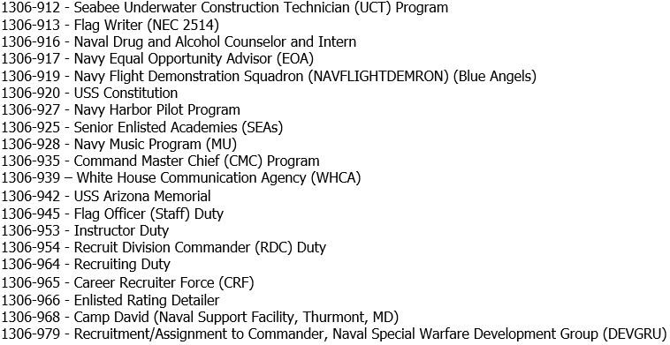
Common Special Duty Assignments (cont.)
Notes:
FACILITATOR GUIDE:
At this point, remind class to ensure they are looking at MILPERSMAN

Slide 31
Knowledge Check
Why is it important to send motivated Sailors to PRECOM duty?
How many Shore Special Programs are there?
Where is the USS Constitution homeported and what is its nickname?
Which NAVPERS screening form is used for most special programs?
Which NAVPERS screening form is used for Recruiting?
Notes:
ANSWERS:
1. PRECOM requires intensive efforts to establish the administrative and training readiness of the unit for future operations and is not equipped to handle excessive personnel-related administrative burdens
2. 26 various programs
3. Boston, MA and “Old Ironsides”
Selection to CPO and commissioning programs.
4. NAVPERS 1306/92
5. NAVPERS 1306/93

Slide 32
Summary and Review
In this lesson we discussed:
  The two categories of Enlisted Special Programs
  The types of sea and shore special programs available
  Eligibility requirements
  The screening forms required for completion

Slide 33

Enlisted Assignment Special Programs

